Slide 1
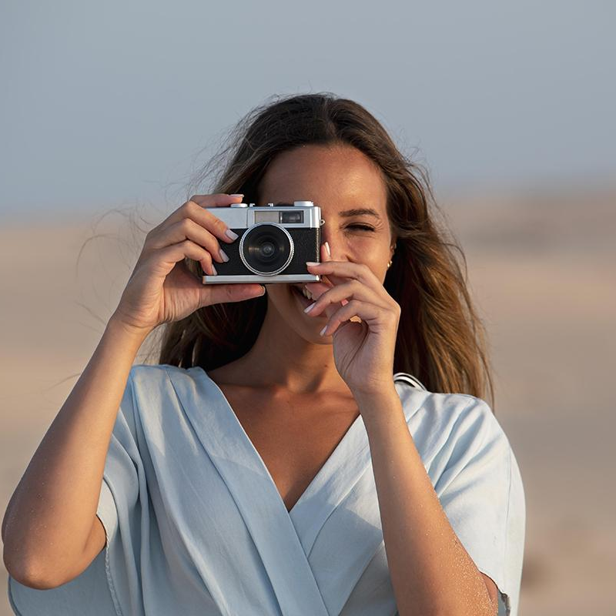
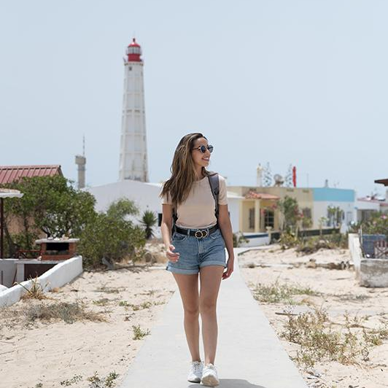
TRAVEL ESCORT
- TEAM 36

Slide 2

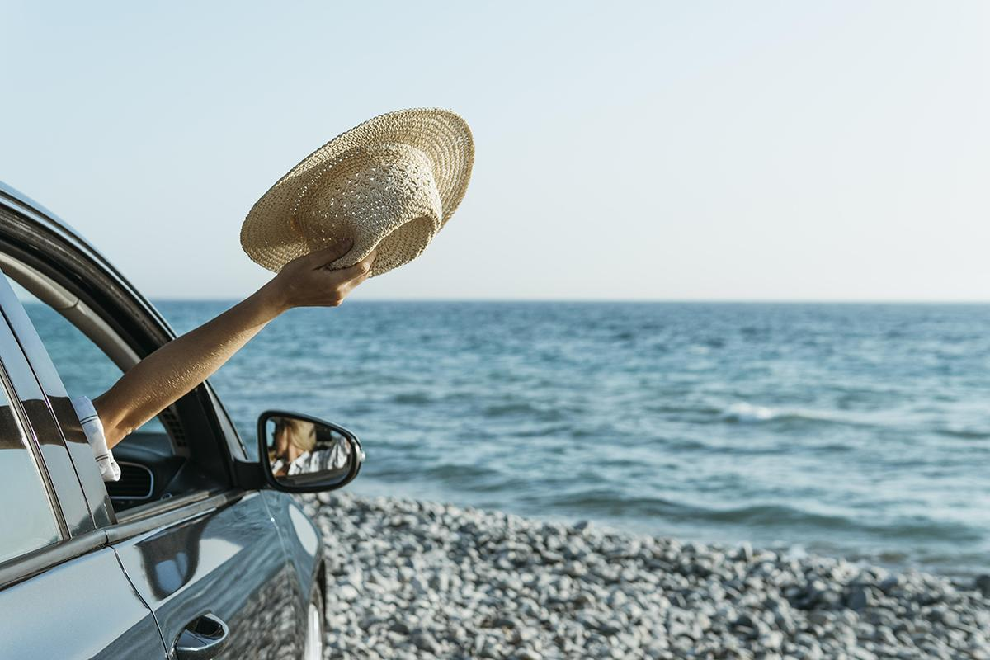
TEAM MEMBERS
NS GAGAN – ENG19CS0194
NAMITHA – ENG19CS0197
NARMATHA – ENG19CS0198
NIVEDHITHA – ENG19CS0211
PAVAN – ENG19CS0220

Slide 3
01
<<PLANNNIG FOR A VACATION…»
—TRAVEL ESCORT IS HERE FOR YOU!

Slide 4
NEXT HOLIDAYS
SUN | MON | TUE | WED | THU | FRI | SAT
 |  | 01 | 02 | 03 | 04 | 05
06 | 07 | 08 | 09 | 10 | 11 | 12
13 | 14 | 15 | 16 | 17 | 18 | 19
20 | 21 | 22 | 23 | 24 | 25 | 26
27 | 28 | 29 | 30 | 31
MYSORE
MANGALORE

Slide 5
MY ESSENTIAL KIT
DOCUMENTS
Carry necessary documents like drivers licensers, RC Book,etc
LOCATION GUIDE
Each place has guidelines to make your journey meaningful.
CAMERA
Creates a memorable timestamp of your journey

Slide 6
INTRODUCTION
Our project is a web application that provides complete information about famous places located in and around Karnataka for tourists and travel enthusiasts.
Our website is filled with various attractions for each of the different locations that we have gathered for our users, and also gives an insight about travel requirements including cuisines, accommodation, transportation facilities within the chosen location.
We have also included travel photography tips for amateurs and professionals as well as road safety tips.

Slide 7
ABSTRACT
Our website acts as a means of providing a wide range of services suitable for individuals seeking relaxing, comfortable and memorable experiences in their desired or chosen location
Usually, a local guide is required to get a hands-on experience on your trip, but the website we have designed can help bridge the gap between the tourists and the location that they wish to travel and assist them in choosing the ideal travel destination
Our website is designed in a manner that would attract the users and ensure that they are given a complete insight required to plan out a trip to the destinations within the circumference of Karnataka.
The design of our website is structured in a way that would keep its customers engaged and would definitely attract them into exploring all the aspects of our website completely.

Slide 8
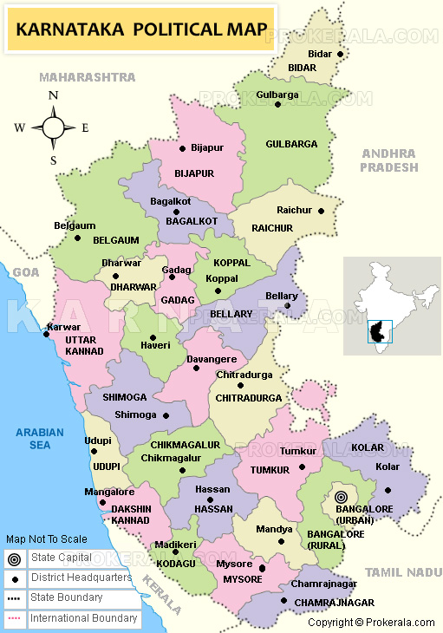
Chikkamagaluru
Coorg
Gokarna
Mysore
Mangalore
Bangalore

Slide 9
OBJECTIVE
Unlike other websites which focuses just on describing the attractions of the place, our website acquaints the user about the offbeat pocket friendly places as well as the most frequently visited places.
Provides a high standard of services suitable for individuals seeking relaxing, comfortable and memorable experiences in the hospitality and tourism industry.
Provides the tourist market with the quality personal required by the tourism industry.
Produces expeditions and memories that would satisfy each and every single of the customers.

Slide 10
WHAT DO WE OFFER?
LOCALHOTELS/ SIGNATURE CUISINES
TRANSPORTATION FACILITIES/CHECKLIST
PHOTOGRAPHY SECTION
TOURIST DESTINATIONS
PHOTOGRAPHY SECTION
LIVE WEATHER REPORT

Slide 11

WHAT SETS US APART?
ANIMATED WEBSITE
EXHAUSTIVE DETAILS
Interactive website that makes you want to go on a vacation!
Detailed objective of the destinations to develop better understanding of the visiting place.
UNSEEN PLACES
CAR BOOKINGS
We have provided destinations of famous places but also unseen heritage treasures.
Having the facility to book car rentals makes you ease your journey.

Slide 12
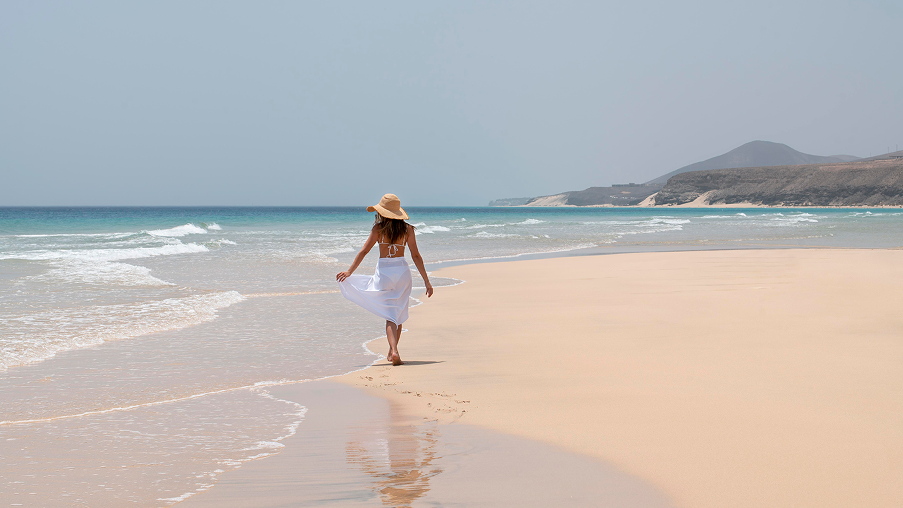
PHOTOGRAPHY SECTION
PICTURE IS WORTH A THOUSAND WORDS

Slide 13
02
FUNCTIONAL REQUIREMENTS

Slide 14
01
HARWARE REQUIREMENTS
02
03
04
32/64 BIT CPU
1 GB DISK SPACE
4 GB RAM
LATEST OS

Slide 15
01
SOFTWARE REQUIREMENTS
02
03
04
MySQL
XAMPP
VISUAL STUDIO
NOTEPAD++

Slide 16
WEB DESIGN
LOGIN PAGE
DESTINATIONS
TRAVEL GUIDELINES
HOTELS

Slide 17
03
CODE SNIPPETS

Slide 18
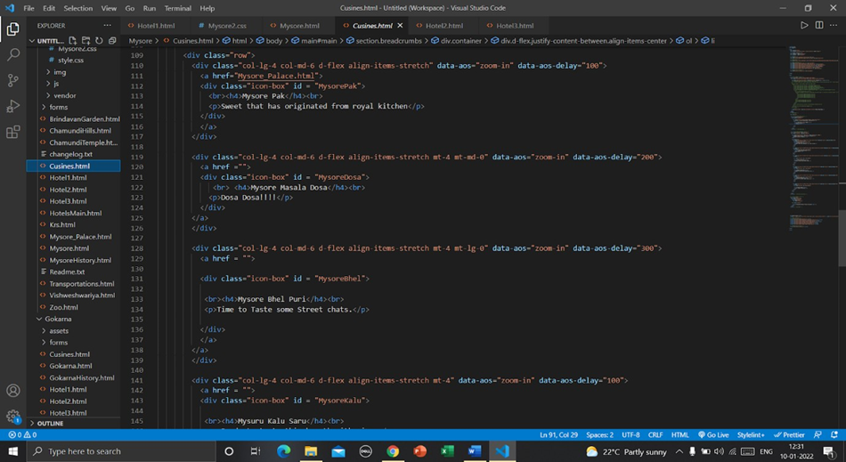
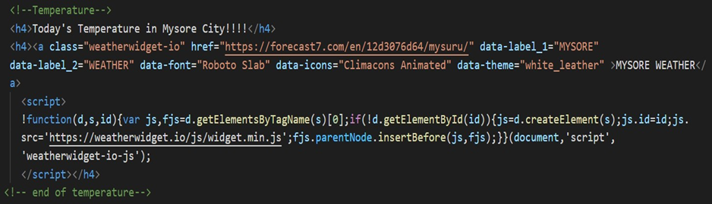

Slide 19

OUTPUT SNIPPETS
Next few slides are the screenshots of the Travel
Escort Website.

Slide 20
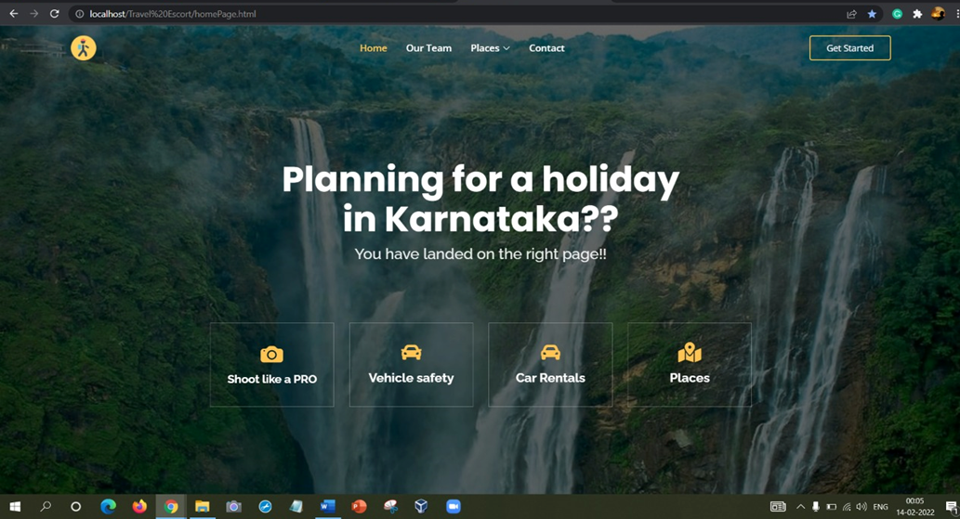
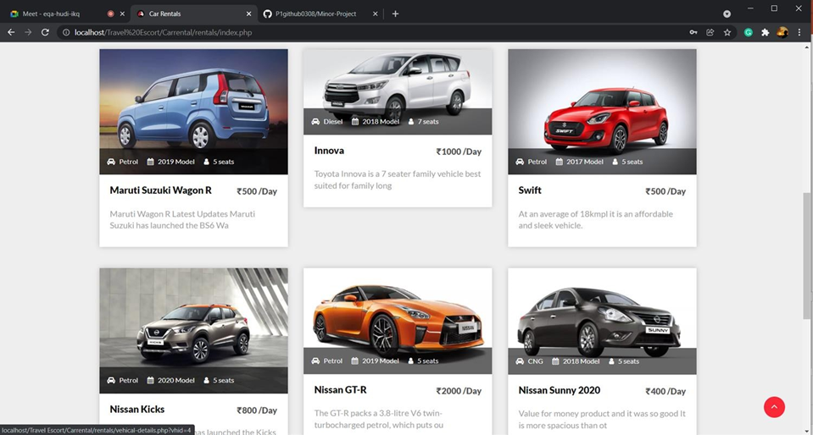

Slide 21
CONTRIBUTIONS
PAVAN
Photography page
Road Safety page
Admin page
Chikkamagalur page
GAGAN
Admin page
Gokarna page
Mysore page

Slide 22
CONTRIBUTIONS
NARMATHA
Customer page
Mangalore page
PowerPoint Presentation
Report
NIVEDHITHA
Customer page
Coorg page
PowerPoint Presentation
Report

Slide 23
CONTRIBUTIONS
NAMITHA
Customer page
Bengaluru page
PowerPoint page
Report

Slide 24
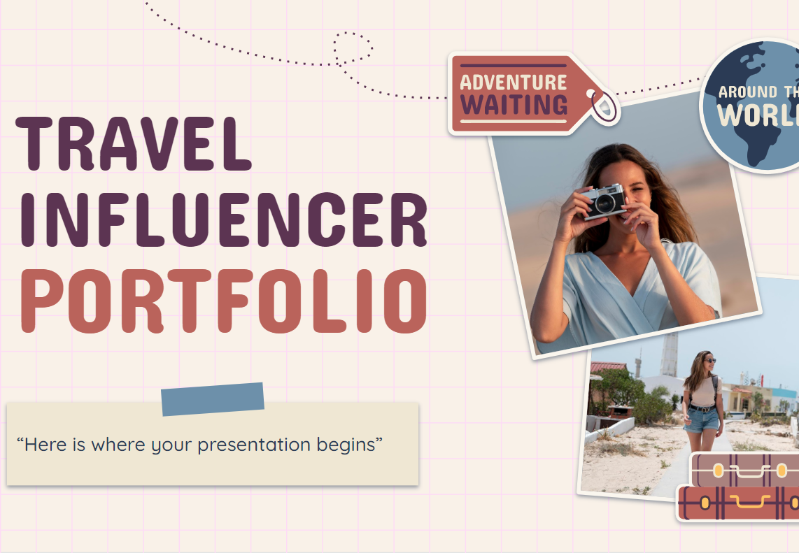
IMPLEMENTATION
VISIT OUR WEB!

Slide 25
CONCLUSION
The overview of this website is to create high quality content .The ultimate goal of our project is to make travelling easier and hassle-free as it would be really time consuming to plan out trip without knowing the city completely. We as a team got to learn on how to approach the development of a website from the scratch and wish to implement the same in any of our future works too. Multiple reviews and suggestions from various panel members and our guide have helped us in the smallest of smallest detailed correction to make the website today. The website Travel Escort can be a great place to find all the information a person needs before he visits the place and we wish to expand this to many more places beyond the borders of Karnataka.

Slide 26
THANK YOU

